Slide 1

e-Project Nextag

Slide 2
Team Member
Nguyễn Thanh Vân
Bạch Ngọc Anh
Nguyễn Thanh Phong
Nguyễn Quốc Khánh
Nghiêm Thái Vũ
MENTOR: Nguyễn Duy Hoàng

Slide 3



Introduction
The IT industry demands rapid learning, skill upgrades, and practical application. Busy schedules, remote locations, and limited time slots hinder implementation. Thus, a laddered approach is necessary for effective application of concepts.
Students face challenges in keeping up with the rapidly changing field of IT due to their busy schedules. Technology plays a crucial role in addressing this need by providing integrated and real-time applications.
At Aptech, we aim to revolutionize education with a live and synchronous eProject learning environment, leveraging technology for an immersive learning experience.

Slide 4

TECHNOLOGY
HTML
Css
JavaScript
ReactJS

Slide 5
Site Map
Website
Home
Product
Compare
Contact Us
All Product
GPS
Watch Now
Gucci
Contact Us
Louis Vuitton
Prada

Slide 6

WEBSITE STRUCTURE
1.Home
2.Product
3.Product Details
4.Compare
5.Contact Us

Slide 7
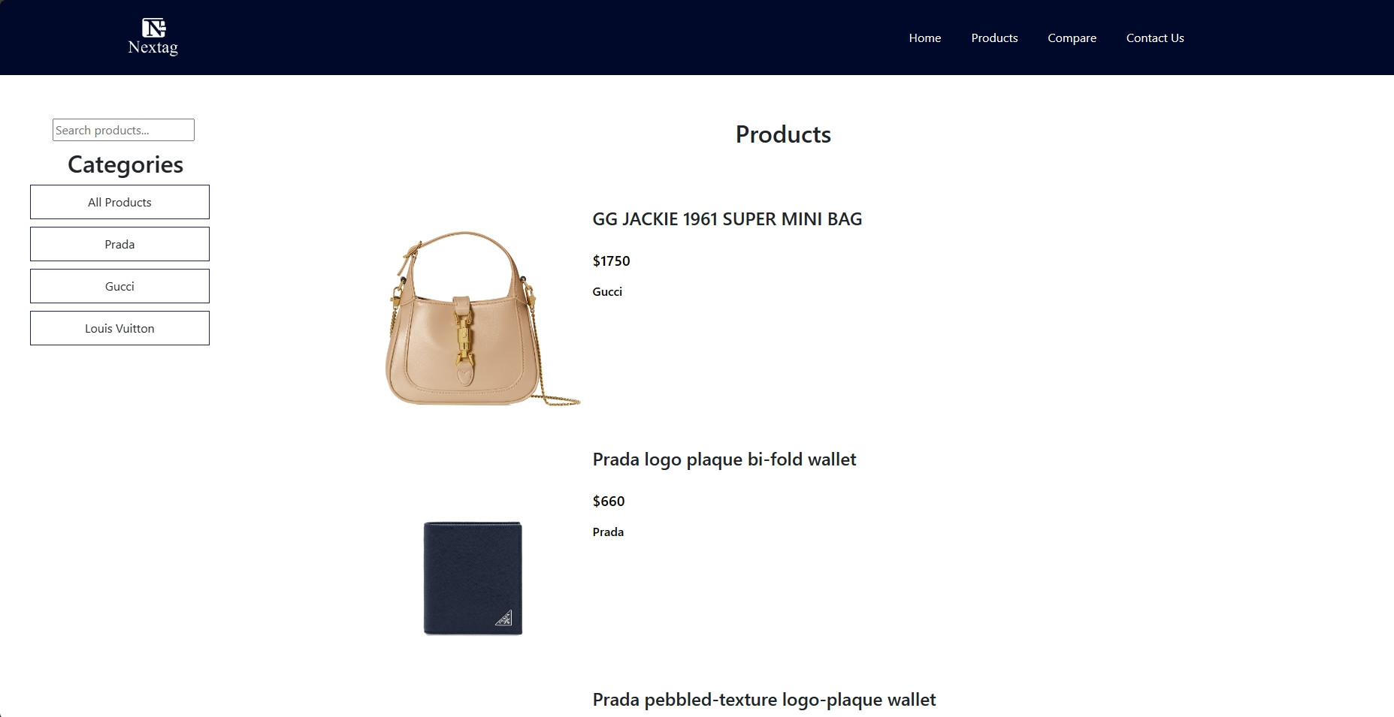
Nextag

Slide 8
Product
You can search for product names, or search for products by brands.

Slide 9
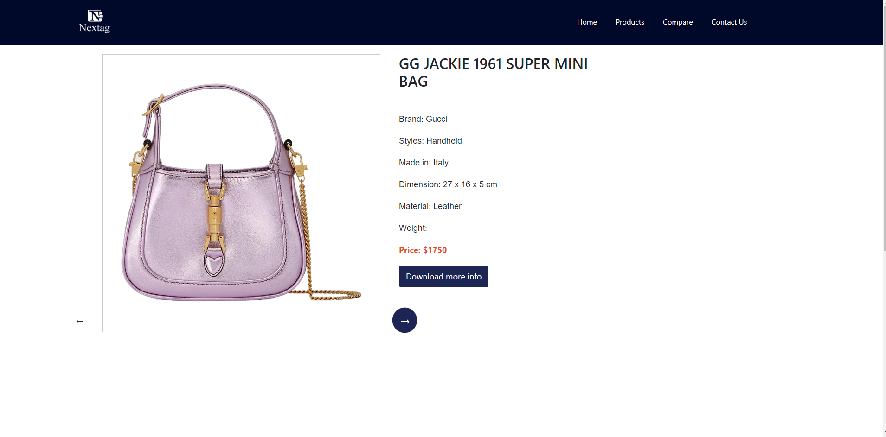
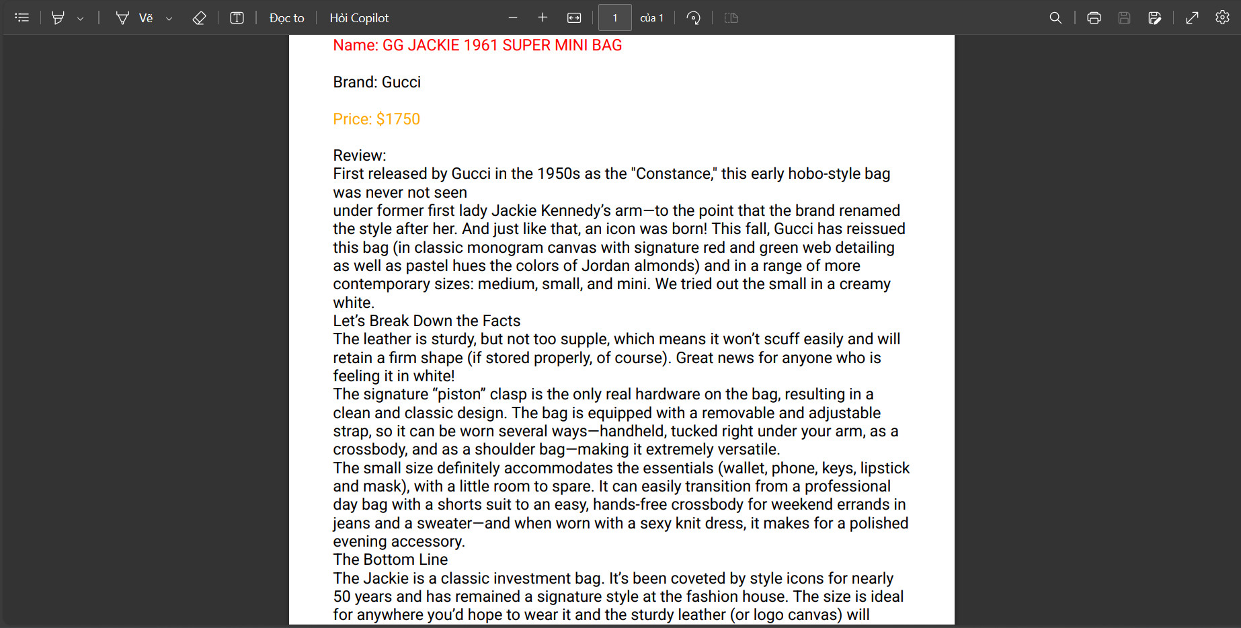
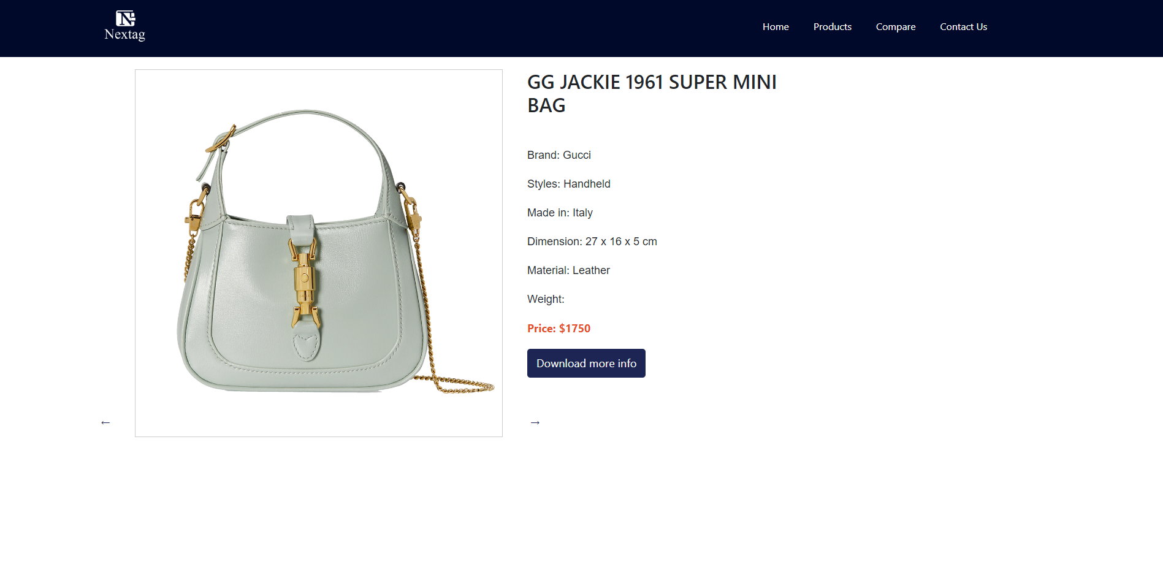
Product Details
You can view multiple photos by clicking the arrow in the lower right corner of the photo.
When you click on the registration button, you can download an PDF file containing product information.

Slide 10
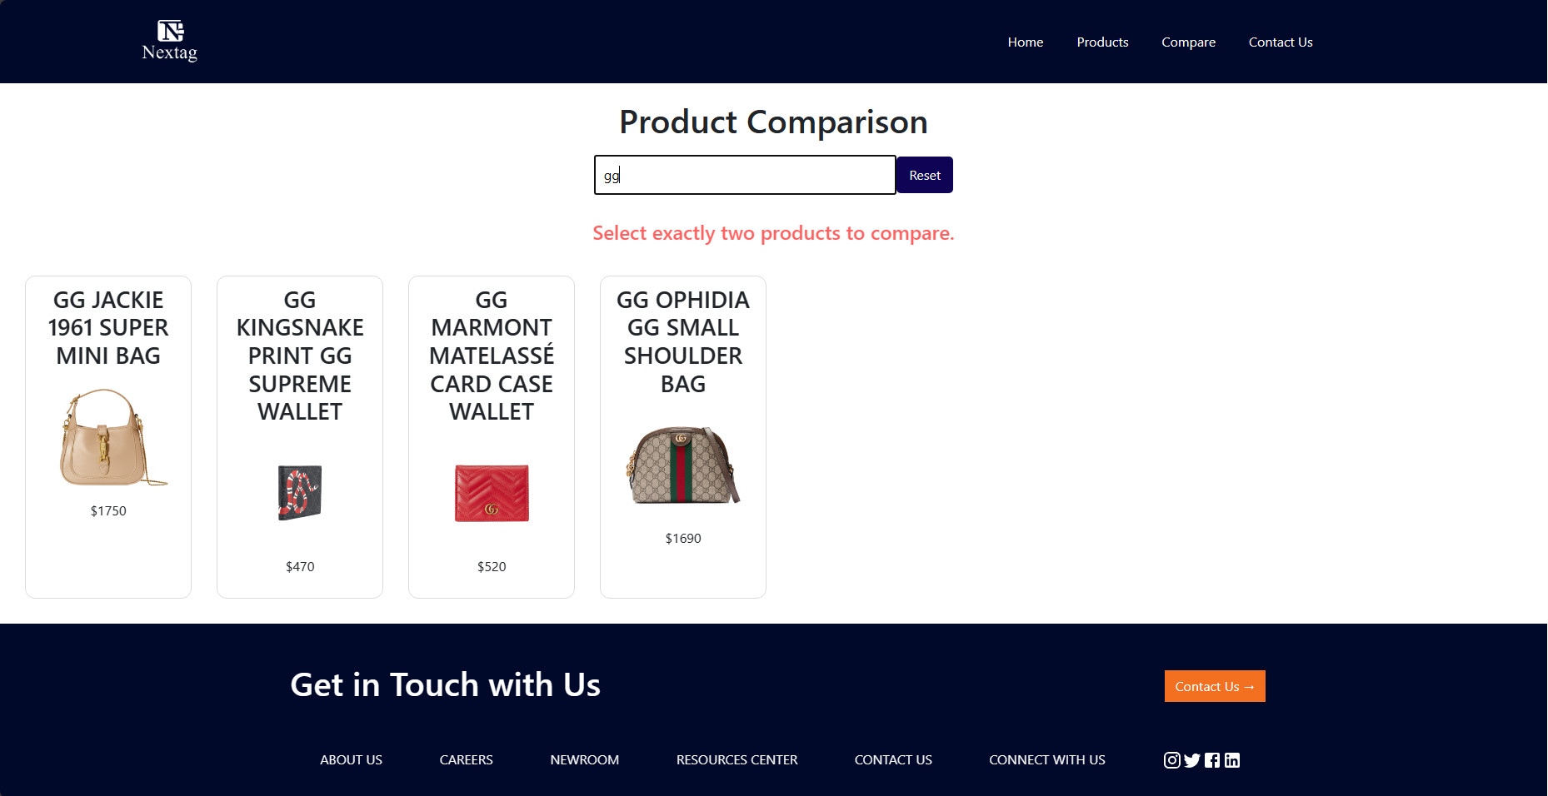
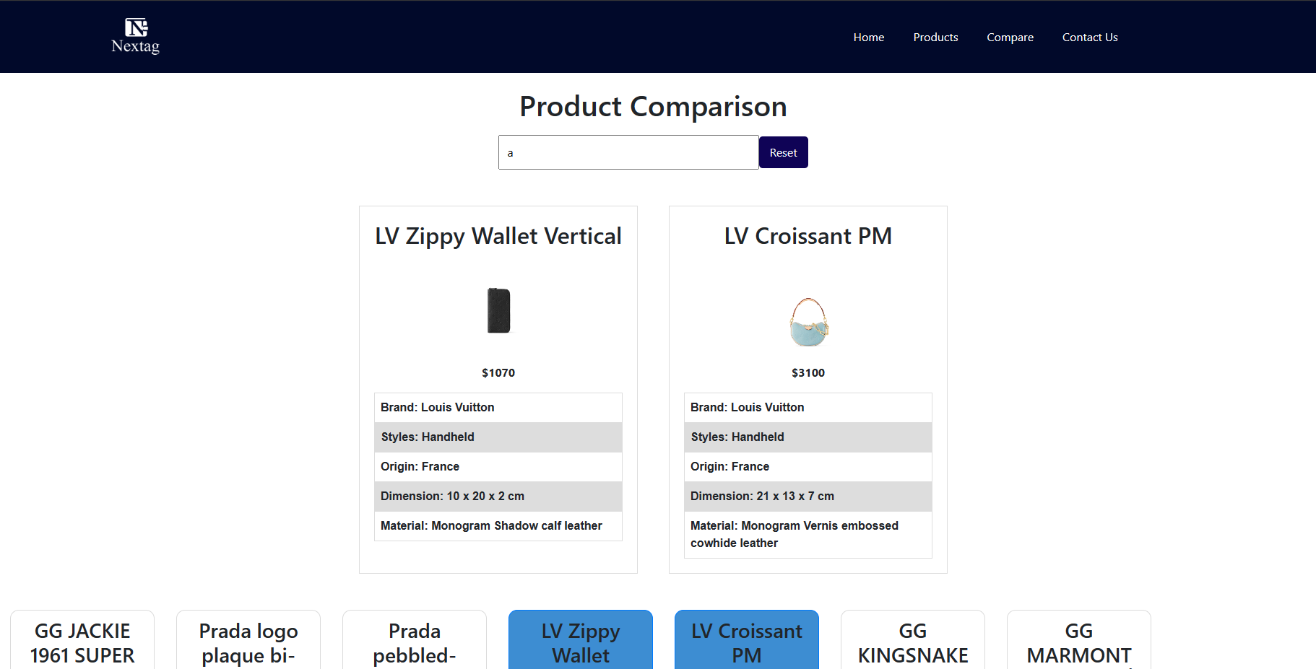
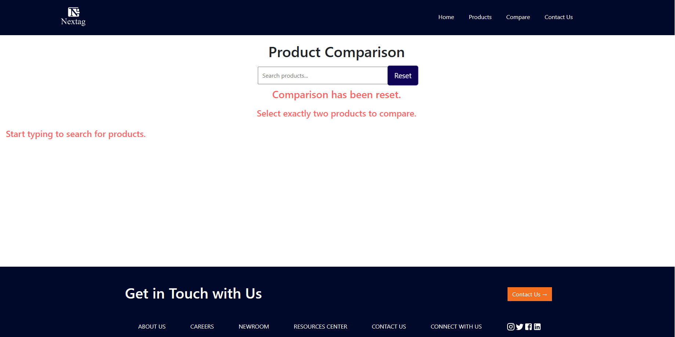
Compare
On this page you need to search and choose 2 products to compare.
When you press reset, everything will return to its original state, and a message will appear for about 1 second.

Slide 11
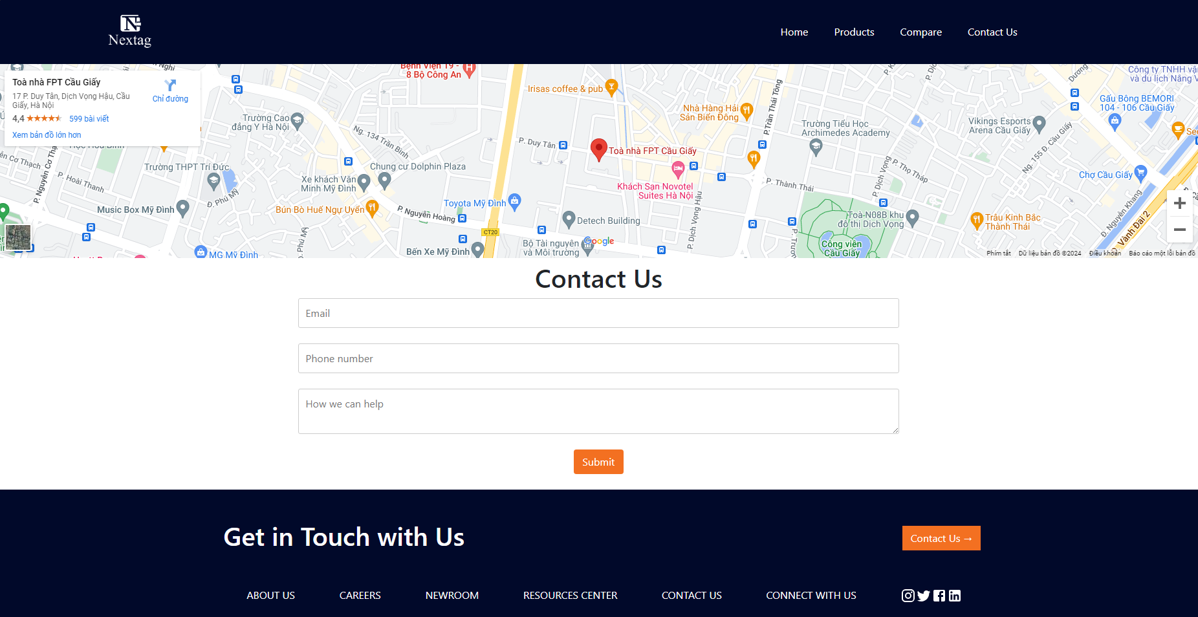
Contact Us
You can view the location displayed on GPS, and contact us by filling out the form below.

Slide 12
THANK YOU!

